Slide 1
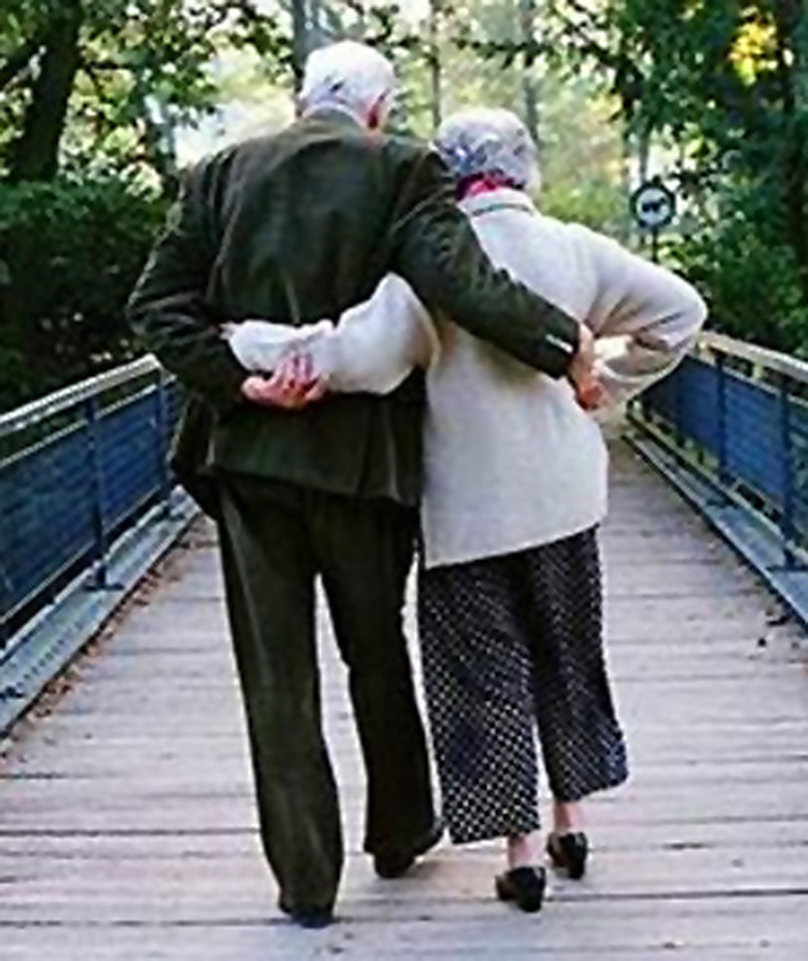
Married: Growing & Serving Together
Discipline & Instruction of Children
What They Most Need
A Study of Marriage, Spring 2023

Slide 2
Discipline & Instruction of Children
What They Most Need
Review
“Fathers, do not provoke your children to anger, but bring them up in the discipline and instruction of the Lord.”— Ephesians 6:4
“Fathers, do not provoke your children, lest they become discouraged.”— Colossians 3:21
Discipline is how what we instruct becomes ingrained in the hearts and actions of our children. Proper discipline is not easy, and Paul warns fathers not to provoke / discourage our children.

Slide 3
We use the word “Discipline” in various ways
Review
Merriam Webster’s Collegiate Dictionary :
From Latin: disciplina - teaching, learning
Punishment 2. Instruction 3. Field of Study
4. Training that corrects, molds, or perfects the mental faculties or moral character.
5... Self-control

Slide 4
“Discipline” in Eph. 6:4 Relates to Training
Review
“Fathers, do not provoke your children to anger, but bring them up in the discipline (training, nurture, chastening) and instruction of the Lord.”— Ephesians 6:4
The Greek is “Paideia,” meaning the rearing of a child, training, discipline. According to Thayer’s Greek Lexicon:
“The whole training and education of children (which relates to the cultivation of mind and morals, and employs for this purpose now commands and admonitions, now reproof and punishment).”
“Whatever in adults also cultivates the soul, especially by correcting mistakes and curbing the passions; hence,
instruction which aims at the increase of virtue: 2 Timothy 3:16.
according to Biblical usage chastisement, chastening”... Heb. 12:5ff

Slide 5
The “True Meaning of Discipline”
Review
“The true meaning of discipline is not punishment, but the development of enough self-control to learn, work, and achieve great things.” – author unknown

Slide 6
Three Areas to Develop Self-Discipline in Our Children:
Disciplined Thinking
Disciplined Emotions
Disciplined Actions

Slide 7
Disciplined Thinking:
Proverbs 4:
23 Keep your heart with all diligence, For out of it spring the issues of life.
Proverbs 23:
For as he thinks in his heart, so is he.
Proverbs 22:
Foolishness is bound up in the heart of a child; The rod of correction will drive it far from him.
Note, we punish children for their actions, but the goal is to change their heart / thinking.
One major area where children need discipled thinking is to learn to respect authority (parents, teachers, police, etc.).

Slide 8
Disciplined Emotions:
James 1:
20 For the anger of man does not achieve the righteousness of God.
Proverbs 27:
4 Wrath is fierce, and anger is a flood, But who can stand before jealousy?
Proverbs 16:
32 He who is slow to anger is better than the mighty,
And he who rules his spirit, than he who captures a city.

Slide 9
Disciplined Emotions:
Genesis 4:
4b-7 “...The LORD had regard for Abel and his offering, but for Cain and his offering he had no regard. So Cain was very angry, and his face fell. The LORD said to Cain, “Why are you angry, and why has your face fallen? If you do well, will you not be accepted? And if you do not do well, sin is crouching at the door. Its desire is contrary to you, but you must rule over it.”
We must teach our children to master their emotions, or else their emotions will master them.

Slide 10
Disciplined Actions:
W.E. Vines, Disciple: “a learner…hence it denotes one who follows one’s teaching… A disciple was not only a pupil, but an adherent; hence they are spoken of as imitators of their teacher.”
The “little disciples” in our charge must learn Self Control of their actions. This will be easier if we have taught them how to control their thinking and emotions.

Slide 11
Disciplined Actions:
Luke 6:
40 “A pupil is not above his teacher; but everyone, after he has been fully trained, will be like his teacher.
46 “Why do you call Me, ‘Lord, Lord,’ and do not do what I say?
Most children will naturally imitate their parents. The profound impact of our example is sobering.

Slide 12
Disciplined Actions:
1 Corinthians 9:
27 but I discipline my body and make it my slave, so that, after I have preached to others, I myself will not be disqualified.
Teaching Self Control and Discipline in Their Actions Will Train Our Children in Willpower

Slide 13
Disciplined Actions:
Willpower Defined:
I won’t engage in wrong actions
I will do what I should
I want… (disciplined thinking about what we really want)
"Discipline is doing what you really do not want to do, so you can do what you really want to do." - John Maxwell
Notes:
For example, I want to please God, my parents, etc.

Slide 14
Several Ways to Develop Self-Discipline in Our Children:
Positive Reinforcement
Extinction Training
Corrective Punishment
“If you do what is right, will you not be accepted?” – Genesis 4:7 (Reinforce completing chores, kindness, etc.)
“When he [Esau] wanted his father’s blessing, he was rejected. It was too late for repentance, even though he begged with bitter tears.” – Hebrews 12:17
“Foolishness is bound up in the heart of a child; The rod of correction will drive it far from him.” – Proverbs 22:15
Notes:
Sometimes temper tantrums are best ignored.
Deut. 3:23-26: “And I pleaded with the LORD ... ‘Please let me go over and see the good land beyond the Jordan, that good hill country and Lebanon.’ But the LORD was angry with me because of you and would not listen to me. And the LORD said to me, ‘Enough from you; do not speak to me of this matter again.’”

Slide 15
A Child Needs to Be Trained to Grow in All Areas of Development
“And Jesus grew in wisdom (mental) and stature (physical), and in favor with God (spiritual) and man (social).” – Luke 2:52

Slide 16
Lessons on Discipline from Heb. 12:5-11
“And have you forgotten the exhortation that addresses you as sons? “My son, do not regard lightly the discipline of the Lord, nor be weary when reproved by Him. For the Lord disciplines the one He loves and chastises every son whom He receives.” It is for discipline that you have to endure. God is treating you as sons. For what son is there whom his father does not discipline? If you are left without discipline, in which all have participated, then you are illegitimate children and not sons. Besides this, we have had earthly fathers who disciplined us, and we respected them. Shall we not much more be subject to the Father of spirits and live? For they disciplined us for a short time as it seemed best to them, but He disciplines us for our good, that we may share His holiness. For the moment all discipline seems painful rather than pleasant, but later it yields the peaceful fruit of righteousness to those who have been trained by it.”
Discipline should be appreciated
Discipline indicates love and care
Proper discipline deserves respect
Parents determine the best discipline
Punishment is unpleasant but such training yields good results

Slide 17
Proverbs on Physical Punishment
“Whoever spares the rod hates his son, but he who loves him is diligent to discipline him.” – 13:24
“Foolishness is bound up in the heart of a child; The rod of correction will drive it far from him.” – 22:15
"Do not withhold discipline from a child; if you strike him with a rod, he will not die. If you strike him with the rod, you will save his soul from Sheol [death].” – 23:13-14
“The rod and reproof give wisdom, but a child left to himself brings shame to his mother.” – 29:15

Slide 18
Discipline: Points to Consider
Parents know their child best and have the primary responsibility for training / disciplining him or her (not school, church, daycare, etc.).
Parents who fail to discipline properly will regret it and will be held responsible by God (Eph. 6:4, 1 Sam. 3:11-14, Prov. 29:15, Prov. 17:25)
Withholding needed punishment from a child is not a sign of love, it shows a lack of love (Heb. 12:5-11, Prov. 13:24, 19:18, 23:13-14)
Each child is different - what works with one (or what worked for you as a child) may not work with another child.
Discipline should change as the child matures. Explain more with age.
Parents make mistakes. Willingly admit this when it happens.
Be a parent, not a buddy.
Invest the time and effort to monitor behavior & correct. Don’t be naïve!
Extend trust / privacy when deserved but be careful. Not a “right.”
Some temptations may be too great for trust (phones, internet, media).
Monitor friends closely. Be their friends’ preferred host yard, kitchen, etc.
Notes:
No punishment is one form of “child abuse!”
You’ve got to be smarter than your children!

Slide 19
Discipline Cautions
Discipline, but never humiliate or physically abuse.
Watch your anger when punishing, you may need to wait.
Use corporal (physical) punishment carefully – think about where and how hard you apply that “loving touch.”
Corporal punishment is best phased out as children get older.
Don’t belittle, disrespect, or verbally abuse.
Remember even though you “outrank” your child, they are of equal value. Always show respect and loving concern.
Don’t discipline or criticize in front of your child’s friends – wait until you have some privacy if at all possible.
Don’t punish in a way that exceeds the wrong committed.
Make reasonable demands – don’t expect too much too soon (be patient), but don’t expect too little.
Don’t confuse threats with punishment – follow through!
Be consistent, be consistent, be consistent!

Slide 20
Discussion Question
How to Discipline Without Discouraging?
The type and intensity of discipline should depend on the wrong committed AND on the age and temperament of the child. The discipline should NOT depend on the mood or fatigue of the parent.

Slide 21
If Your Child Did This, How Would You React?
Procrastinated cleaning room
Lied to you (Does the answer depend on the type of lie?)
Showed lack of respect toward you (verbal, nonverbal, tone, ignoring)
Blamed someone else when they were actually the guilty party
Arguing with you over something you’ve asked them to do
A pattern of disobedience or repeated disobedience
Would not share their things with others
Took away another child’s toy when they were playing with it
You find something in their pocket they have taken (stolen) from a store
You confront for disobedience and, they confess /express remorse
You confront for disobedience and, they deny it (lie)
You catch them trying to sneak out at night
They break something or spill something
They embarrass us with their behavior or something they say
They hit, bite, pinch, or otherwise hurt another person
They get in a fight at school for unknown reasons

Slide 22
The End

Slide 23
August 9, 1980

